Slide 1

Supported ionic liquid membranes for selective separation of volatile organic vapour and pollutants from gas stream
LD14094 (04/2014–04/2017)
Zuzana Petrusová (Sedláková)
Membrane Separation Group (leader Dr. Pavel Izák)
at Institute of Chemical Process Fundamentals of the Czech Academy of Sciences, v.v.i.
COST INFORMATION DAY in the Czech Republic
Notes:
COST action: EXIL = European network for Exchange of knowledge about Ionic Liquids

Slide 2






EXIL (European network for Exchange of knowledge about Ionic Liquids)
Google pictures
Notes:
+ my post-doctoral internship at ITM (Institute of Membrane Technology, Calabria, Italy)

Slide 3
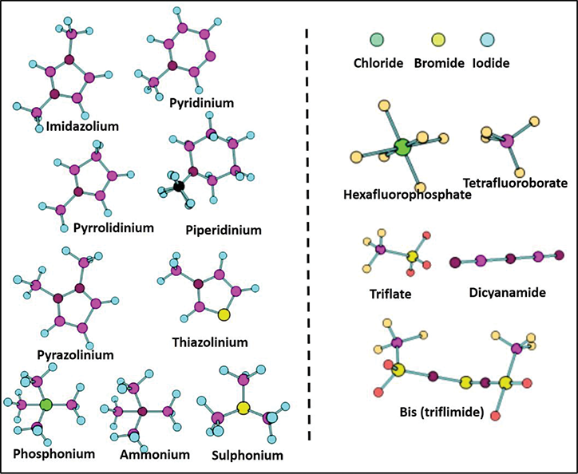
IONIC LIQUIDS
... they are magic
…. they conduct electricity
…. they do not evaporate
… they are said to be green solvent …
Unsymmetrical organic cation and organic/inorganic anion
Salts (neutral) that are liquid at low temperature (below 30°C) … RTILs
Works at mild conditions
Google pictures

Slide 4
IONIC LIQUIDS
Rapid growth of interest
Tailored to address the needs of a specific application
High thermal stability and chemical inertness
Relatively low cost
Easily separated and recycled
Non-toxic to enzyme or fermentation
Notes:
Rapid growth of interest in the last decade
Unique properties influenced their potential and current applications

Slide 5
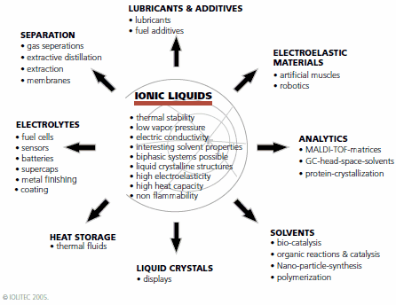
IONIC LIQUIDS

Slide 6
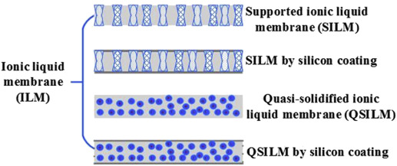
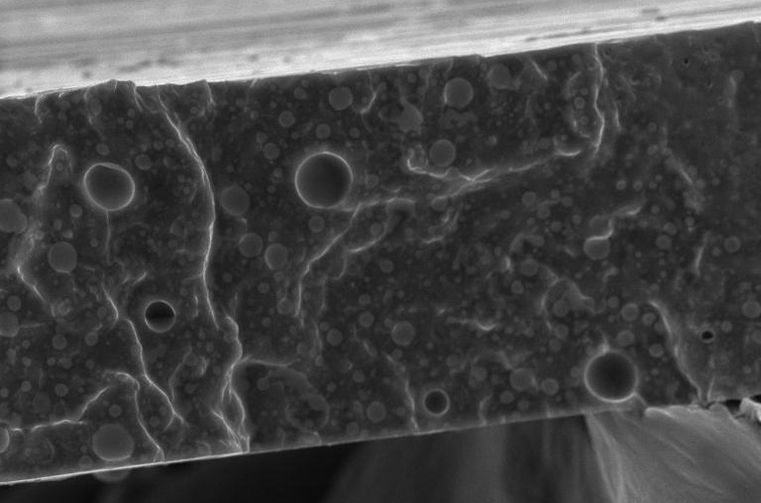
How to prepare membrane with IL?
50 μm
Google pictures
Notes:
Filling the porous support
Coating the surface of the porous support
Silicone coating …
Mixing IL with an apropriate polymer and evaporating the solvent on Petri dish
Casting knife (polymer + IL)

Slide 7
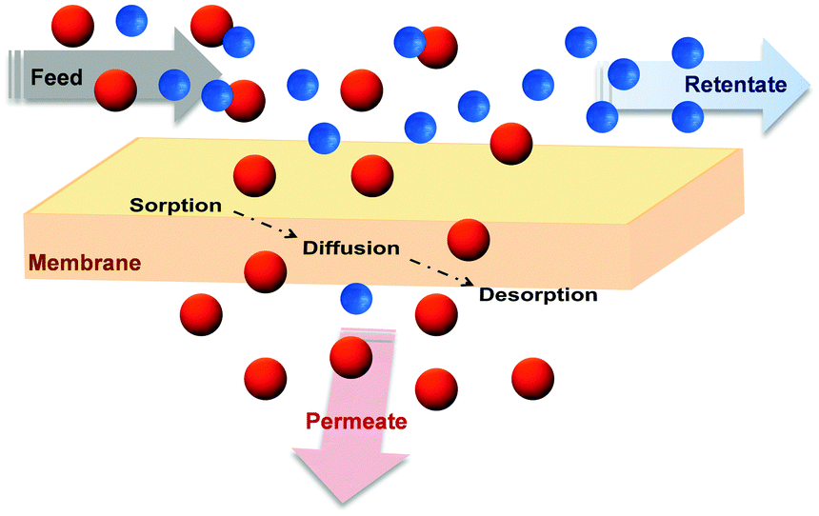

Membrane separation
membrane
Google pictures
heart of membrane process
key parameter for the successful
of membrane separation
Notes:
… adding of IL can be the right key for the improvement of transport and separation properties …. However, we have to find the right key and such a task is not easy!

Slide 8
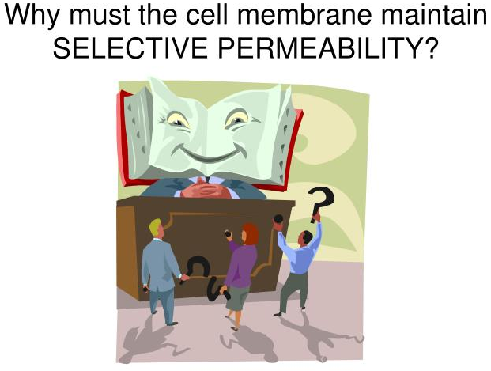
Robeson plot
upper bound
upper bound
thermally re-arranged (TR) polymers
ideal selectivity
Google pictures

Slide 9
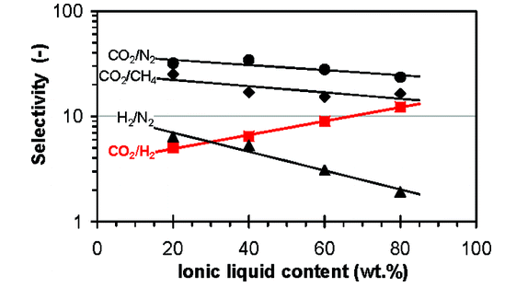
Improvement of separation properties thanks to IL
J. Jansen et al.: High ionic liquid content polymeric gel membranes: preparation and performance, Macromolecules 2011, 44 (1), pp 39–45

Slide 10
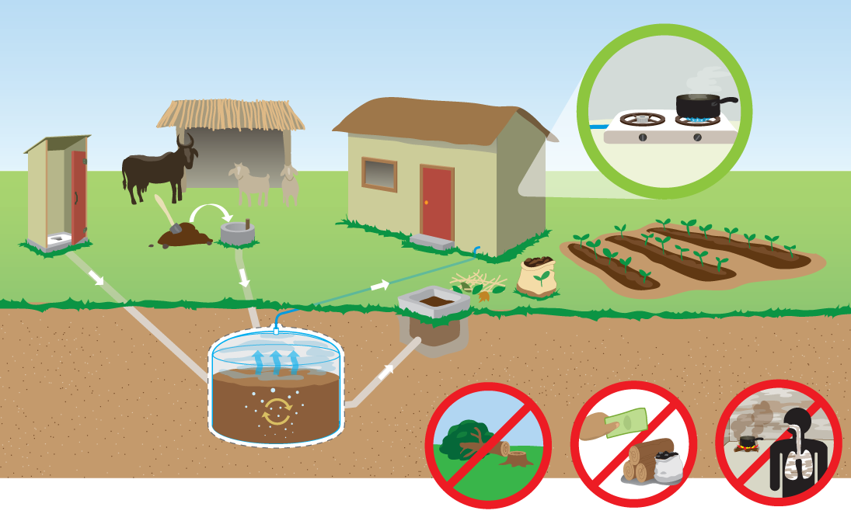
Biogas as a source of ecological energy
Gaseous mixture contains mostly CH₄ and CO₂
Other components like H₂S, NH₃ or siloxanes are present in trace concentrations
Exact composition of biogas depends on its origin
  sewage digester
  farm biogas plant
  landfill
and can vary at different seasons
Biogas rises during anaerobic digestion of animal and vegetable waste.
Google pictures

Slide 11
Biogas upgrading processes
Drying – water vapor removal
Desulfurization
Removal of other trace compounds (ammonia and siloxanes)
Carbon dioxide removal
  Absorption (water scrubbing, ammines)
  Adsorption (porous solids – zeolites or active carbon)
  Cryogenic separation
  Membranes separation

Slide 12
Membrane separation
polyimides (PI)
facilitated transport membranes
mixed matrix membranes (MMMs)
carbon molecular sieves (CMS)
polyethyleneoxide (PEO)
liquid membranes (LMs)
Energy savings
Environmental friendliness
Easy handling
Continuous process
Compact design and small footprint
A. Brunetti, F. Scura, G. Barbieri, E. Drioli: Membrane technologies for CO₂ separation. Journal of Membrane Science 359 (2010) 115–125.

Slide 13
Gas permeation apparatus
1: permeation cell,
2: raw biogas flow controller,
3: CH₄ flow controller,
4: CO₂ flow controller,
5: N₂ flow controller,
6: humidifier (6a at T_{lab} and 6b is heated),
7: temperature and humidity sensor,
8,9: cold traps,
10: back pressure regulator,
11: retentate flow meter,
12: permeate flow meter,
13: three-way electromagnetic valves,
14: IR analyzer.

Slide 14
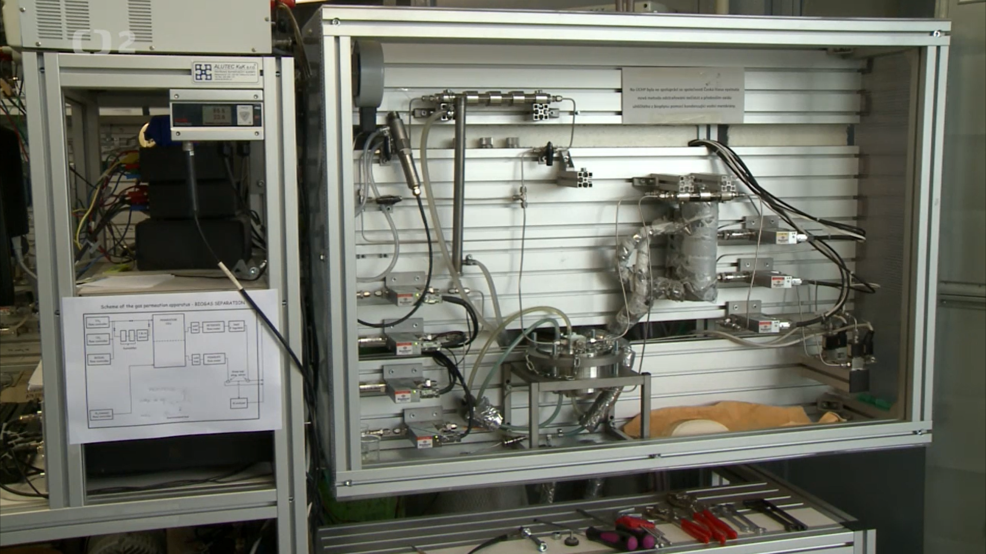
Gas permeation apparatus

Slide 15
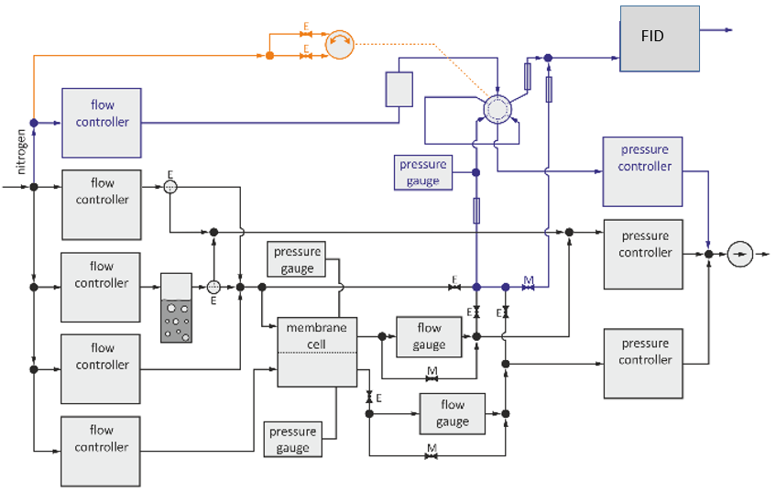
Organic vapour separation
Modification:
Cold trap for permeate stream
Innovation:
Inline-FID analyses of all streams

Slide 16
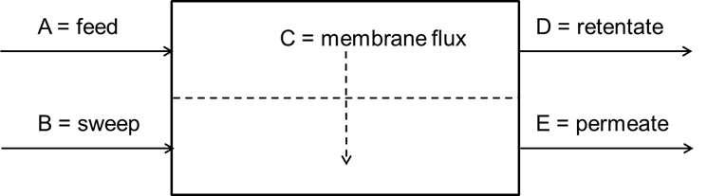
Study of vapour permeation

Slide 17
Study of vapour permeation
Ethanol vapour permeation in LDPE membrane
Ethanol vapour permeation in IL membrane
L. Morávková et al./Chemical Papers 68 (12) 1739–1746 (2014)

Slide 18
Study of vapour permeation
Hexane and isooctane permeation in IL membrane
IL membrane: hexane removal up to 30mol. % × poly(vinylidene fluoride-co-hexafluoropropylene) membrane is impermeable
L. Morávková et al./Chemical Papers 68 (12) 1739–1746 (2014)

Slide 19
Summary of representative published results within the project
Study of sorption properties
Randova A. et al.: A New Prediction Method for Organic Liquids Sorption into Polymers. J. Membrane Sci. 475, 545-551 (2015).
Randova A. et al.: Sorption of Organic Liquids in Poly(ethylene chlorotrifluoroethylene) Halar®901: Experimental and Theoretical Analysis. Polym. Test 58, 199-207 (2017).

Slide 20
Study of vapour transport properties
Moravkova L. et al.: Vapour Permeation and Sorption in Fluoropolymer Gel Membrane Based on Ionic Liquid 1-Ethyl-3-Methylimidazolium bis(trifluoromethylsulfonyl)Imide. Chem. Pap. 68(12), 1739-1746 (2014).
Vopicka O. et al.: Ethanol Sorption and Permeation in Fluoropolymer Gel Membrane Containing 1-Ethyl-3-Methylimidazolium bis(Trifluoromethylsulphonyl)Imide Ionic Liquid. Chem.Eng.Process. 94(SI), 72-77 (2015).
Petrusova Z. et al.: Comparison of Hexane Vapour Permeation in Two Different Polymeric Membranes via an Innovative In-Line FID Detection Method. Chem. Biochem. Eng. Q. 31(2), 145-160 (2017).

Slide 21
Study of gas permeation – review papers
Karaszova M. et al.: Progress in Separation of Gases by Permeation and Liquids by Pervaporation Using Ionic Liquids: A Review. Sep. Purif. Technol. 132, 93–101 (2014).
Karaszova M. et al.: Gas Permeation Processes in Biogas Upgrading: A Short Review. Chem. Pap. 69(10), 1277–1283 (2015).
Izak P. et al.: Catalytic Ionic-Liquid Membranes: The Convergence of Ionic-Liquid Catalysis and Ionic-Liquid Membrane Separation Technologies. ChemPlusChem 83(1), 7-18 (2018).

Slide 22

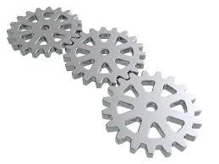

WHAT DID THE EUROPEAN CONTACTS BRING TO US?
Students training, post-doctoral internship
and fruitful contacts with new trends at the specialised institutes
WHAT CAN WE OFFER TO THE WORLD?
Handy workshop and ingenious apparatuses
Notes:
[in:džínies]

Slide 23

… FOR YOUR KIND ATTENTION
FINANTIAL SUPPORT FROM CZECH MINISTRY OF EDUCATION, YOUTH AND SPORTS
(COST PROJECT LD 14094) IS GREATLY APPRECIATED.

