Slide 1
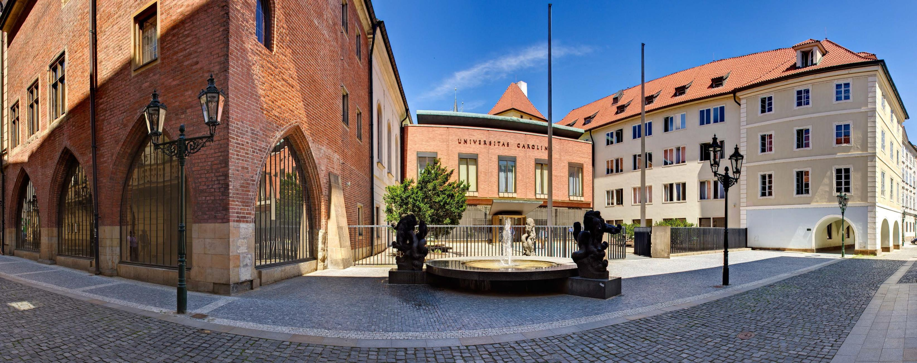
About Charles University
Recognition of foreign education
at Charles University
Milena Králíčková, Charles University March 25th, 2021

Slide 2
Programme
Obsah
Introduction of Charles University
General recognition of foreign higher education previous and contemporary practice, changes
Assessment of foreign secondary and higher education for the purpose of admission process
proceedings, practice
Problems in the recognition practice

Slide 3

Charles University
History:
Rich tradition, founded at 1348
3 Nobel prize winners
Charles University today:
17 faculties
over 48 000 students (20% foreign students)
over 500 study programmes
around 8 000 graduates per year
in rankings: belongs to 2% of the best world universities

Slide 4
General recognition of foreign higher education
Based on:
Higher Education Act („HEA“), Lisbon Convention, other international agreements
Assessment: higher education study programmes only
Main conditions to be assessed:
Accreditation of the institution and of the study programme
Completion of the level of previous study required by Czech law
Relevant level of study programme
Document proving the recognition is valid generally.
Everybody can apply for a general recognition.
In case of negative decision possibility of appeal to the Ministry of Education, Youth and Sports (MEYS).

Slide 5
General recognition in the past and nowadays
Recognition practice
In the past…
Recognition practice
Now…
Till 12/2019
Recognition in the specific study programme
Applications were assessed first by the rectorate (main conditions) and then by a faculty (comparison of the content of study programme)
This recognition practice is kept by medical faculties
Time consuming proceeding, bureaucratically demanding
Since 1/2021
Recognition in the field of study covering the study programme
Main conditions of recognition assessed by the rectorate
Comparison of the content of study by a faculty for medical study programmes only
More flexible and time saving proceeding, Lisbon Convention fully applicable

Slide 6
Reasons leading to changes in general recognition practice
Why Charles University has changed the general recognition practice?
Reaction to the recognition practice of MEYS – more simple and flexible process keeping the quality of recognition
MEYS considered „substantial differences“ for negative decisions of Charles University as non substantial and recognized according to the Lisbon Convention.
Trends in Europe – interconnectedness of universities and decrease in bureaucracy
Chances for recognition of studying programmes not realized at Charles university, recognition in a field of study covering the foreign study programme

Slide 7
Changes in general recognition practice
Recognition practice
In the past…
Average processing time of the application:
2 months
Bureaucratically demanding
A lot of negative decisions due to substantial differences
Recognized by MEYS in appeal proceedings according to Lisbon Convention
Recognition practice
Now…
Average processing time of the application:
1 month
Effectivity of the proceeding
Decrease in number of negative decisions
Flexible recognition according to Lisbon Convention

Slide 8
Impact of changes in general recognition practice
For applicants
Advantages
Processing of the application in shorter time
Higher probability of the positive result of decision on recognition at university – without need to appeals to MEYS
Disadvantages
Recognition in the field of study covering the study programme, not in a specific study programme
It might cause misunderstanding for the authority recognizing professional qualification
For university
Advantages
No need to forward applications to faculties (exception: medical study programmes )
No need of assessment of a detailed content of study
Disadvantages
Necessity to issue a document specifying that foreign study programme is related to a study programme required for the recognition of professional qualification

Slide 9
Assessment of foreign secondary and higher education for the purpose of admission process
The possibility of assessment was generally set out by amendment to HEA 2016
HEA gives this possibility to Charles University based on the institutional accreditation gained 2018
At Charles University since admission process related to academic year 2018/2019
Modifications of the system – for applicants, for faculties
Support to faculties – consultations, trainings, methodology

Slide 10
Assessment of foreign secondary and higher education for the purpose of admission process
Assessment valid for a particular admission process only
Valid for applicants to study programmes realized at Charles University only
Assessment of foreign secondary and higher education
No separate decision (a part of admission process)
Not to be assessed: content of study programmes
To be assessed:
- Accreditation of the institution and of the study programme
- Completion of the level of previous study required by Czech law
- Relevant level of study programme
Time saving and cost saving

Slide 11
Impact of assessment of foreign secondary and higher education for the purpose of admission process
For aapplicants
Advantages
Time saving and cost saving
No need to take a process of general nostrification (strict requirements of authorities recognizing foreign secondary education)
Disadvantages
Valid just for a specific admission process
The result of assessment cannot be used for other institutions
For ffaculties
Advantages
Flexible assessment without necessity to ask for a certificate of general recognition
More convenient for admission process
Cost efficient for faculties
Disadvantages
Bureaucratic burden

Slide 12
Assessment of foreign education
for the purpose of admission process in the practice
Increasing number of applications for recognition of foreign education for the purpose of admission process
Most often assessed applications from:
Russian Federation
United Kingdom of Great Britain and Northern Ireland
United Arab Emirates

Slide 13
Problems and difficulties in recognition and assessment practice
Inconsistency of databases
Differences in admission requirements
Title of academic degree and a duration of study programme
Issuing of a diploma with a delay
Master degree integrated into doctoral degree
Disputable qualifications
- Secondary education according to British curriculum
- German qualifications Fachschulreife with access just to Fachhochschule
- Intermediate qualifications within the first cycle (i.e. Bachelor Ordinary)
- Intermediate qualifications within the second cycle (i.e. Postgraduate Diploma)

Slide 14
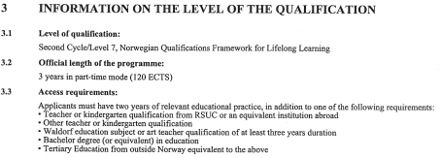
Differencies in admission requirements 1
Consecutive master degree admission requirements according to HEA in CZ
Completion of any type of higher education degree programme
At least EQF 6 (bachelor degree)
Consecutive master degree admission requirements in foreign countries
In some countries (nordic countries, USA, UK) their national requirements are different from requirements of HEA in CZ – in some cases for the admission process level not reaching bachelor degree is also sufficient
Even EQF 5 or EQF 4 together with experience in the field (problem for recognition in CZ - requirement of HEA not fulfilled)
For example…
Diploma Supplement Norway

Slide 15
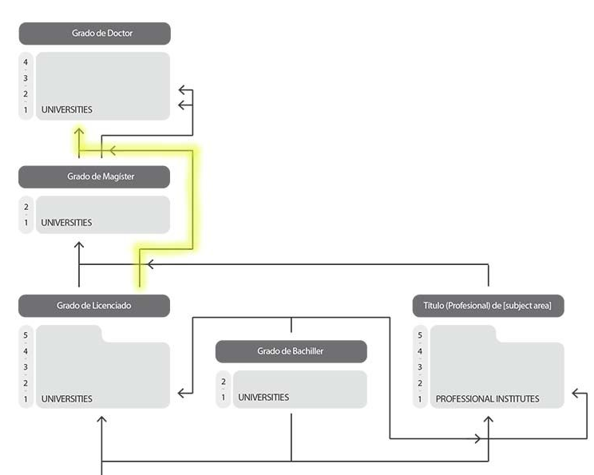
Differencies in admission requirements 11
Doctoral degree admission requirements according to HEA in CZ
Completion of studies in a Master degree
Doctoral degree admission requirements in foreign countries
In some cases (Latin America, USA, GB) completion of bachelor degree is sufficient
Problem for recognition: admission requirement set by HEA in CZ not fulfilled
Requirement set by HEA is fulfilled if consecutive master degree is implemented into doctoral study programme
For example…
Educational system Chile

Slide 16
Support for higher education institutions (HEI)
How can MEYS help
Help with problematic questions regarding the assessment of foreign secondary education for the purpose of admission process
Methodical meetings of HEI of CZ and MEYS to discuss difficulties concerning recognition practice

Slide 17

Thank you for your attention!
Contact: Prof. MUDr. Milena Králíčková, Ph.D., milena.kralickova@ruk.cuni.cz
Rectorate of Charles University
Documents, Registers and Recognition of Foreign Degrees Office
nostrifikace@ruk.cuni.cz

