Slide 1
Technologické infrastruktury (TI) v ERA a ČR
Ondřej Hradil, vedoucí oddělení výzkumných infrastruktur, rektorát, Masarykova univerzita
11. 9. 2025
Dny výzkumu, vývoje a inovací, Brno

Slide 2
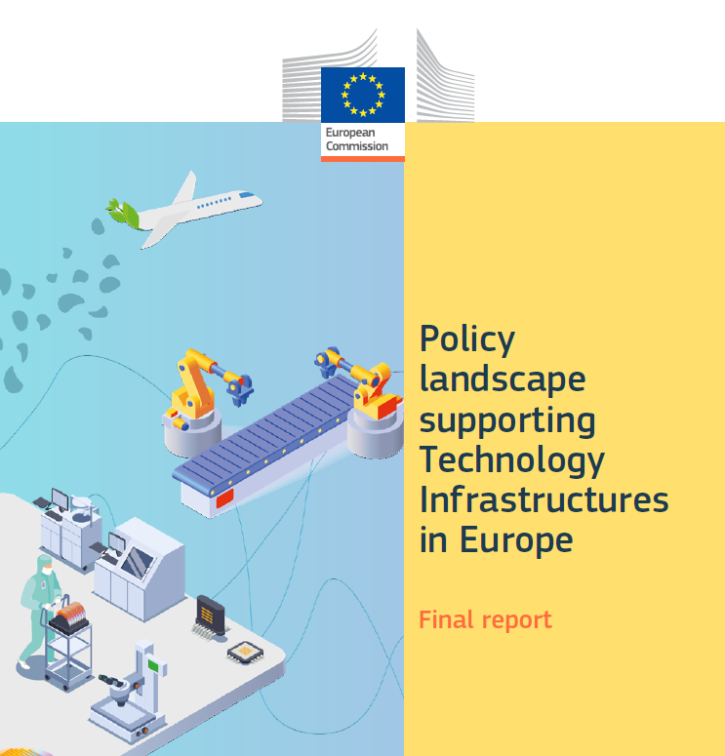
Pozadí a kde to začalo?
COMMISSION STAFF WORKING DOCUMENT: Technology Infrastructures, SWD(2019) 158 final, 8.4.2019
Policy landscape supporting Technology Infrastructures in Europe, 2024
Tlak na větší konkurenceschopnost
  Draghi report, srpen 2024
  Competitiveness Compass, leden 2025

Slide 3
Pozadí a kde to začalo?
Technology Infrastructures are necessary for European competitiveness:
Technology Infrastructures (TIs) play a crucial role in driving innovation and competitiveness in Europe.
They provide the essential facilities, equipment, and resources needed to scale research from the laboratory to the market.
TIs are particularly important for SMEs and start-ups, enabling them to de-risk investments and accelerate commercialization.
As Europe aims to lead the green and digital transitions, strengthening the TI ecosystem is vital for industrial competitiveness and technological sovereignty.

Slide 4
Expertní skupina Evropské komise pro technologické infrastruktury

Slide 5
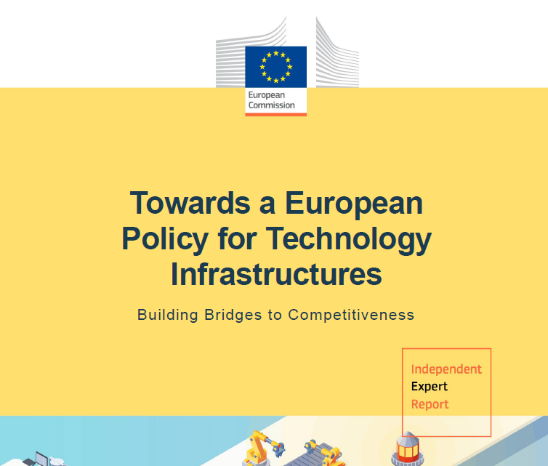
Expertní skupina EK pro TI
22 členů, 3 typy stakeholderů
  Členské státy: CZ, PT, NL, DE, DK, BE, PL, NO
  Organizace zastupující průmysl, RTOs, univerzity provozující TIs, evropské VI: SMEUnited, Brainport Development, CEA, VTT, INESC, Ghent University, Chalmers, ERIC forum chair, ESRF, …
  Další EU instituce se vztahem k agendě TI: EIB, ESFRI
Zástupce ČR: Ondřej Hradil, MUNI
Pro období 1/2024-2/2025
2 výstupy:
  Towards a European Policy for Technology Infrastructures
  User Needs for Technology Infrastructures

Slide 6
Návrh definice (Recommendation 1)
Technology Infrastructures are facilities, equipment, capabilities and resources required to develop, test, upscale and validate technology. They enable and accelerate technological innovations towards societal/market adoption, fostering industrial competitiveness. They provide a wide range of capacities and services from pre-competitive applied research services, through demonstration and validation of technology, up to small-scale production. They include, amongst others, test beds, demonstration and testing facilities, pilot lines or living labs, usually embedded within non-profit research and technology organisations, universities active in technology fields or technology centres, which are open to private and public users. They can be public, semi-public or privately owned, physical or digital.

Slide 7
Co jsou a nejsou TI?
Test beds
Demonstration and testing facilities
Pilot lines, např. financované ChipsJU
Living labs
Cleanrooms
EDIHy – European Digital Innovation Hubs
TEF - Testing and Experimentation Facilities
Regulatory sandboxes
…

Slide 8
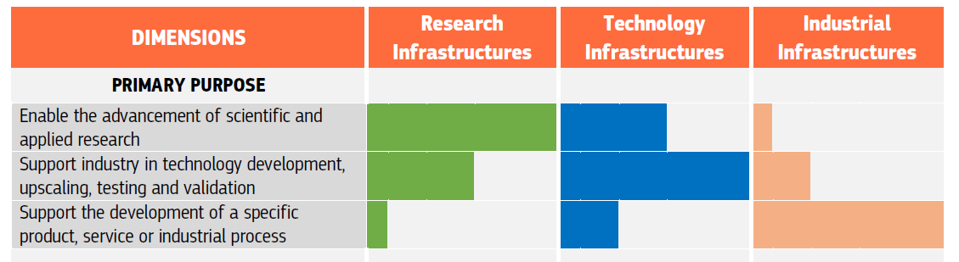
Charakteristiky TI – 7 dimenzí
Výzkumné, technologické a průmyslové infrastruktury a jejich rozdíly

Slide 9
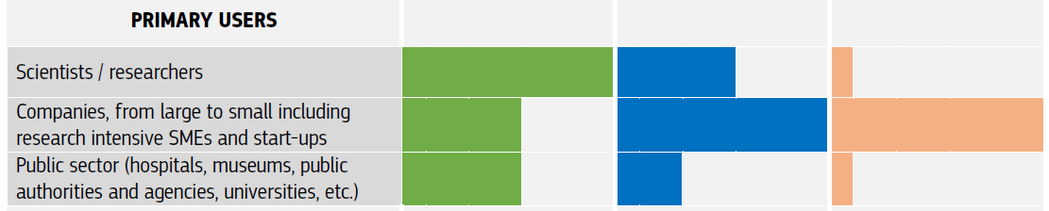
Charakteristiky TI

Slide 10
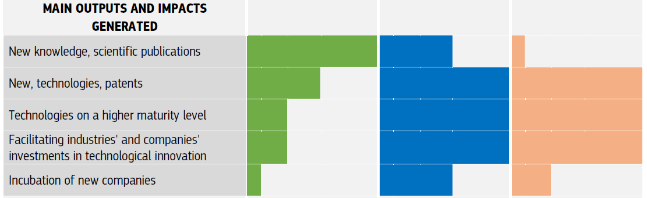
Charakteristiky TI

Slide 11
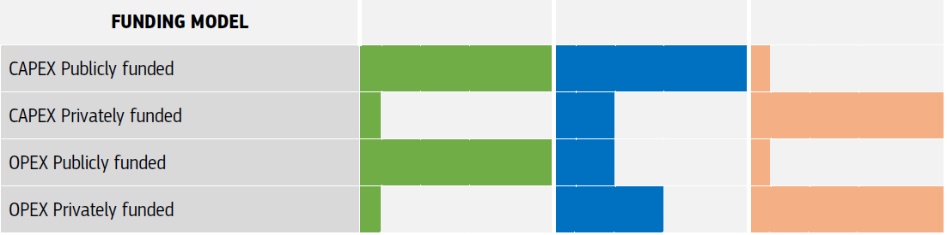
Charakteristiky TI

Slide 12
5 hlavních doporučení (Recommendations)
Formalise the definition of Techology Infrastructures
Improve access to Technology Infrastructures
Develop an effective investment prioritisation mechanism for European Technology Infrastructures
Establish at EU level a robust governance framework for Technology Infrastructures
Establish funding programmes dedicated to Technology Infrastructures at European and national levels

Slide 13
R2: Improve access to TIs
Key challenges:
Limited financial and human resources to engage with TIs.
Lack of visibility and information about available TIs.
Access conditions to TIs can be discouraging due to legal, financial, and administrative frameworks, complex collaboration models, etc.
Barriers to cross-regional and transnational access.
EGTI recommends:
The development of a European Charter for Access to TIs, providing guidelines on streamlined, simple and transparent access procedures.
To develop support measures to improve the visibility of TIs and the services they can offer across the EU.
To increase the opportunities and support for companies to access the infrastructures, including those located in other regions or countries.

Slide 14
R3: Investment prioritisation mechanism for TIs
Key challenges:
There is no investment prioritisation mechanism at EU level and it is also rare at national levels.
Insufficient collaboration among users, TI operators and funders, and between Research Infrastructures (RIs) and TIs on building up infrastructure capacities.
EGTI recommends:
Establishing an EU level investment prioritization mechanism aligned with industrial needs and EU policy priorities.
Priorities should be guided by a robust set of criteria including strategic relevance, feasibility and impact, industrial ecosystem development, addressing service and facility gaps, and financial viability.
Building interconnected networks of RIs and TIs that span sectors and regions, enhancing synergies and creating more integrated and efficient innovation ecosystems across the EU.
Implementing a limited set of pilot actions designed to test a European approach to TIs. The implementation of such pilots could be facilitated by the EU under Horizon Europe, as well as other relevant programmes.

Slide 15
R4: Governance framework for TIs
Key challenges:
At EU level: Limited, fragmented and uncoordinated actions, lack of common vision and priorities.
At Member States level: lack of national TI strategies and funding programmes in many countries.
Lack of a dedicated ‘discussion space’ on TIs at EU level, incl. exchange of views and experiences, identifying priorities, challenges, etc.
EGTI recommends:
Establishing a multi-actor governance framework consisting of two layers:
  Horizontal coordination: Strategic planning, investment prioritisation, and mutual learning.
  Thematic coordination: Networks of TIs focused on key technology areas and coordination of funding for agreed TI investments.
  To be implemented first as a light advisory structure.

Slide 16
R5: Funding programmes
Key challenges:
Funding opportunities for TIs are currently fragmented and uncoordinated, undermining the development of state-of-the-art facilities and their accessibility across the EU.
EGTI recommends establishing dedicated funding for TIs:
At EU level through programmes supporting R&I and competitiveness and at national/regional levels (including allocating funding from the European Structural and Investment Funds).
With a pooling of public and private funding resources to support large-scale investments in TIs agreed at the EU level.
To facilitate access to TIs for users where funding is an important barrier, such as SMEs, start-ups and scale-ups.
To develop TI services and support upskilling of staff, to strengthen delivery and uptake.
To foster collaboration and networking among TIs, and between TIs and RIs.
State aid

Slide 17
Co dál na evropské úrovni

Slide 18
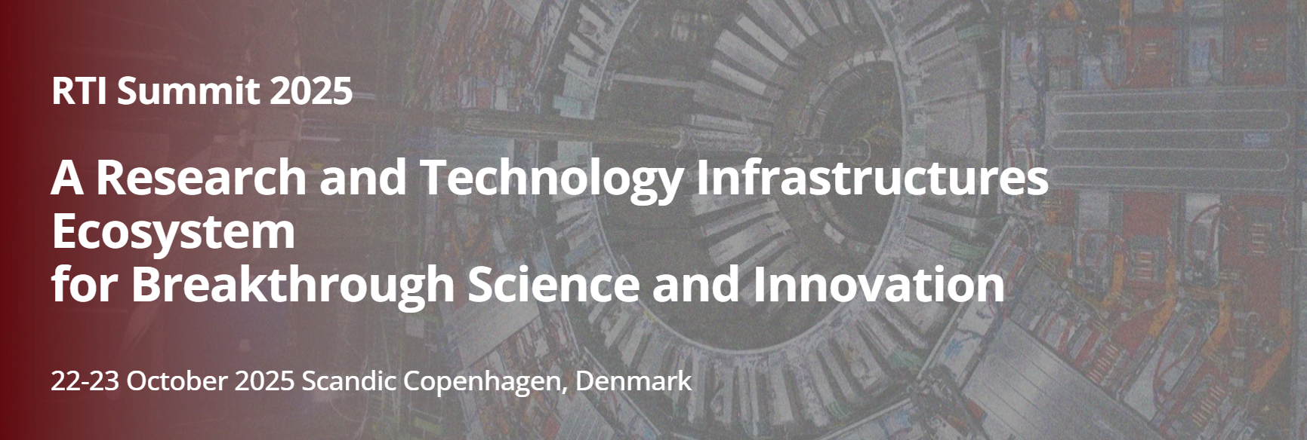
Co dál na evropské úrovni
Strategie pro výzkumné a technologické infrastruktury Evropské komise – představení v týdnu 15. - 19. 9. 2025
RTI Summit: A Research and Technology Infrastructures Ecosystem for Breakthrough Science and Innovation, Kodaň, 22. - 23. 10. 2025

Slide 19
Co dál na evropské úrovni
Výzvy Horizon Europe - HORIZON-CL4-INDUSTRY-2025-01-HUMAN-64: Pilot initiatives on Technology Infrastructures (CSA)
  5 projektů s rozpočtem 0,5-1 mil EUR
  Uzávěrka: 23. 9. 2025
Mapování technologických infrastruktur, různé iniciativy:
  Advanced materials, Biotechnologies
  Clean and renewable technologies
  Report on Open Innovation Testbeds
  Pilot initiative on European Aviation RTIs
  RITIFI projekt: biomedical, clean hydrogen, circular materials, superconducting magnets, microelectronics

Slide 20
Co dál na evropské úrovni
ERA policy agenda 2025-27 – pokračování některých aktivit:
  TI governance structure
  Implementation of TI pilots
  …

Slide 21
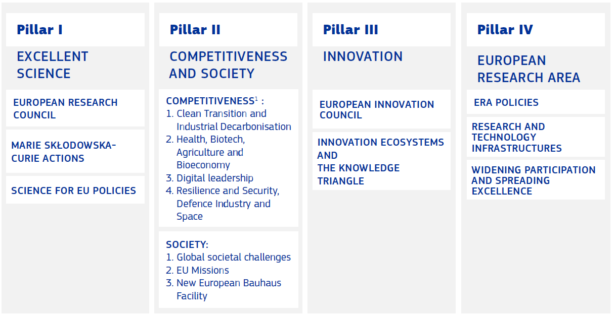
Co dál na evropské úrovni
Výzkumné a technologické infrastruktury v FP10

Slide 22
Technologické infrastruktury v ČR

Slide 23
TI v České republice
Aktuálně nejsou definované
Nový zákon o výzkumu, vývoji, inovacích a transferu znalostí, (328/2025 Sb.), účinnost od 1.1.2027
Nový pojem: Testovací a experimentální infrastruktura (systémová podpora) = testovací a experimentální infrastruktura dle (GBER), kterou schválila vláda
Gestor: Ministerstvo průmyslu a obchodu

Slide 24
RIFF - Research Infrastructures for the Future of Ukraine: Roadmap for Sustained Growth and Recovery

Slide 25
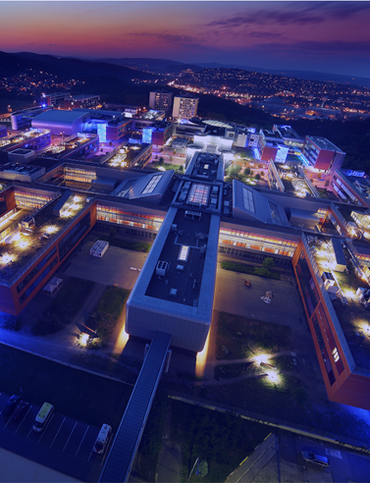
RIFF basics
Title: Research Infrastructures for the Future of Ukraine: Roadmap for Sustained Growth and Recovery (RIFF)
Starting date: 1. 9. 2025
Duration: 36 months
Budget: 2 million EUR

Slide 26



Objectives
Developing
a Roadmap
Building RI
Community in Ukraine
Promotion of
the Roadmap
Analyse the landscape of RIs in Ukraine and assess their damage caused by the Russian invasion
Bottom-up: Run an Open Call for proposals for RIs in Ukraine
Top-down: Identify priority directions for RI development in Ukraine in light of Green and Digital transition and in coherence with key state policies in diverse socio-economic sectors
Integrate the results of bottom-up and top-down into a roadmap with clear prioritisation
Build awareness and understanding of RIs concept to enable Ukrainian institutions to formulate initiatives for the establishment and development of RIs
Develop training programmes to enable efficient management of RIs in Ukraine
Network Ukrainian RIs with their counterparts in European Research Area (especially, but not exclusively, ESFRI projects and landmarks)
Facilitate community building among RI users, RI managers, and RI policy-makers in Ukraine to build the ground for sustainable use and evolution of the RI Roadmap
Inform and engage international RI communities about the Roadmap, with specific focus on policy-makers and funders that may invest in the implementation of RIs prioritised in the Roadmap

Slide 27
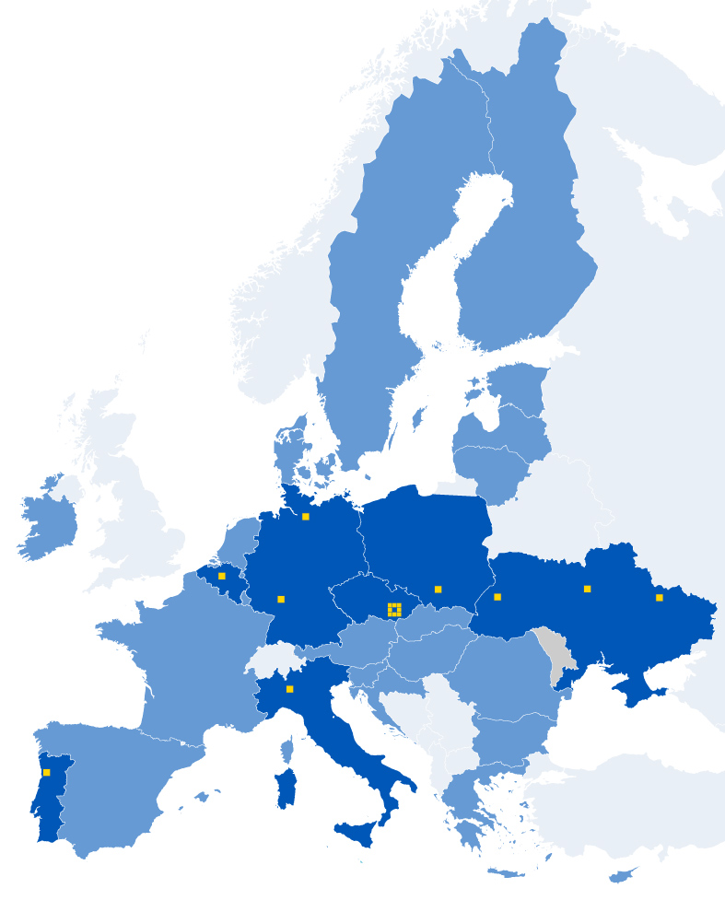
Partners
COORDINATOR: Masaryk University (MUNI), Czechia
Deutsches Elektronen-Synchrotron (DESY), Germany
European Future Innovation System Centre (EFIS), Belgium
Leibniz Institute for the Social Sciences (GESIS), Germany
Institute of Molecular Biology and Genetics NASU (IMBG), Ukraine
Institute of Systems and Computer Engineering (INESC), Portugal
Kyiv Academic University (KAU), Ukraine
Kharkiv Institute of Physics and Technology (KIPT), Ukraine
Lviv Polytechnic National University (LPNU), Ukraine
National Academy of Sciences Ukraine (NASU), Ukraine
National University of Kyiv-Mohyla Academy (NaUKMA), Ukraine
National University of Life and Environmental Sciences of Ukraine
(NUBIP), Ukraine
Jagellonian University (SOLARIS), Poland
University of Milano-Bicocca (UNIMIB), Italy
(Associated) National Research Foundation of Ukraine (NRFU), Ukraine

Slide 28


