Slide 1

Good practices for the implementation of automatic recognition
Silvia Bianco
SEARCH ENGINE project
07.12.2021

Slide 2


Automatic recognition
We will ensure automatic recognition of academic qualifications and periods of study within the EHEA so that
students, staff and graduates are able to move freely to study, teach and do research. We will make the necessary
legislative changes to guarantee automatic recognition at system level for qualifications delivered in EHEA
countries where quality assurance operates in compliance with the ESG and where a fully operational national
qualifications framework has been established. We also encourage the application of agreed and secure systems of digital certification and communication such as blockchain, as well as the further development of the Database of External Quality Assurance Results (DEQAR) to facilitate automatic recognition.
Rome Communiqué, 2020
In an increasingly globalised context, it is important that students can make the best possible use of all learning opportunities across Europe. For this to happen, a qualification awarded by a competent authority in one Member State should be valid in any other Member State for the purpose of accessing further learning activities. This includes third-country nationals who hold a qualification from one Member State and move to another Member State. However, the lack of this automatic recognition of qualifications and the outcomes of learning periods abroad is hampering mobility. A Union-wide approach to automatic recognition will provide the needed clarity and consistency to overcome remaining barriers […]
Explore, in cooperation with Member States, the potential of new technologies, such as blockchain technology, to facilitate automatic mutual recognition.
Council Recommendation of 26 November 2018 on promoting automatic mutual recognition of higher education and upper secondary education and training qualifications and the outcomes of learning periods abroad, 2018

Slide 3
qENTRY+ focus group with higher education institutions
20th of April 2021
5 Italian higher education institution representatives (admission officers)
Objective:
Investigating the understanding of the concept of automatic recognition;
collecting useful information of the practices for the implementation of automatic recognition that are in place;
gaining a better understanding of the main benefits and challenges perceived regarding the concept and the practice of automatic recognition.

Slide 4
qENTRY+ focus group with higher education institutions
Findings and challenges:
Identification of the two distinct moments of recognition as “access” and “admission”
The term “automatic recognition” may generate expectations from the students
Substantial differences
The transparency of the higher education institutions towards applicants
The need to define the relation between the objective criteria established by law and the higher education institutions’ autonomy
Tools and practices:
International and shared tools (Q-ENTRY database)
ENIC/NARIC website (CIMEA website)
The document “Procedures for entry, residency, and enrolment of international students and the respective recognition of qualifications, for higher education courses in Italy for the academic year 2021-2022” published by the Ministry for Universities and Research of Italy (national guidelines)

Slide 5
qENTRY+ focus group with higher education institutions
Suggested responses:
Work more on the academic guidance for students in the choices of their educational careers
Students could be also guided in the knowledge of the recognition procedures and the stakeholders involved
Training activities intended both as refresher training course for HEIs’ staff and training for new resources dedicated to credential evaluation, including policy topics such as automatic recognition
Networking is also considered to be a key aspect in fostering automatic recognition (i.e. conferences for credential evaluators of different HEIs at national and international level)
Cooperation among national higher education institutions and relevant stakeholders is considered to be an essential element
Clear information on the needed documents with regards to recognition of qualifications

Slide 6
Practical Example – Transparency of information provided
The documentation requested by CIMEA is relevant in order to understand the elements of the foreign system and those of the qualification to be evaluated.
As the assessment is carried out on a case-by-case basis, and also considering the fact that a qualification may have been obtained following different paths, the documentation requested by CIMEA is based on each individual case and may vary depending on the foreign country of reference of the qualification, where the studies took place and the institution(s) involved in the procedure.
6

Slide 7
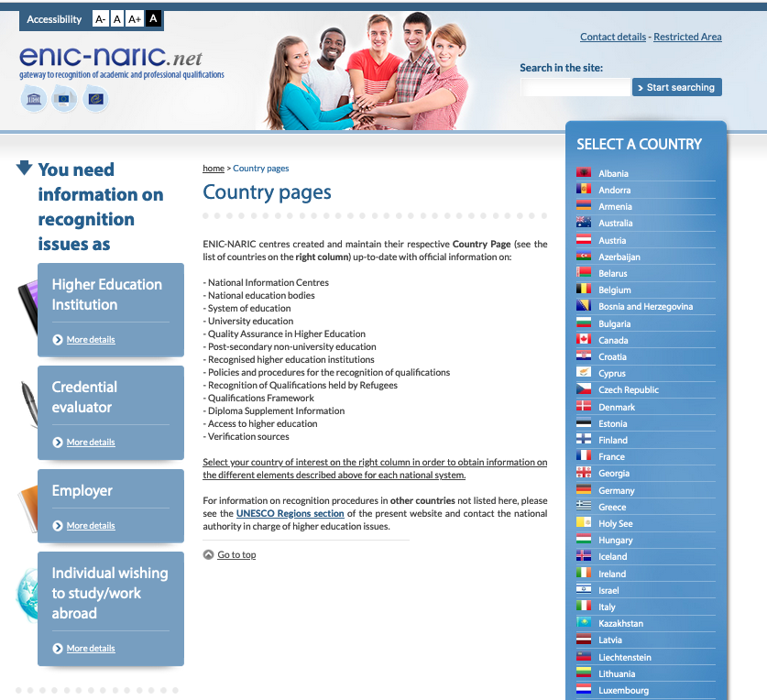

Information sources
Information provided by ENIC-NARIC centres – www.enic-naric.net

Slide 8
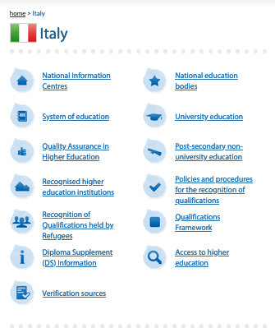
Information sources
Information provided by ENIC-NARIC centres – Verification sources

Slide 9
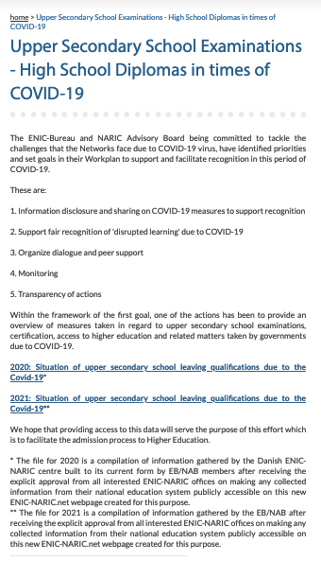
Information sources
Information provided by ENIC-NARIC centres
Impact of COVID-19 on Upper Secondary School Examinations
2020:
https://www.enic-naric.net/fileusers/9975_2020-COVID-19_INFO_UPPER_SECONDARY_SCHOOL_EXAMS.pdf
2021:
https://www.enic-naric.net/fileusers/9224_2021-COVID-19_INFO_UPPER_SECONDARY_SCHOOL_EXAMS.pdf

Slide 10
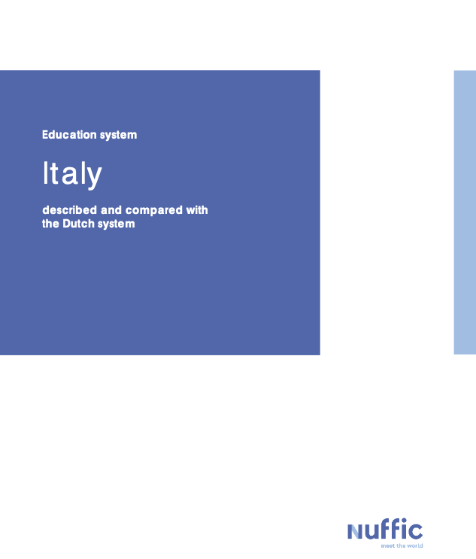
Information sources
Country profiles – https://www.nuffic.nl/en/subjects/diploma/education-systems

Slide 11
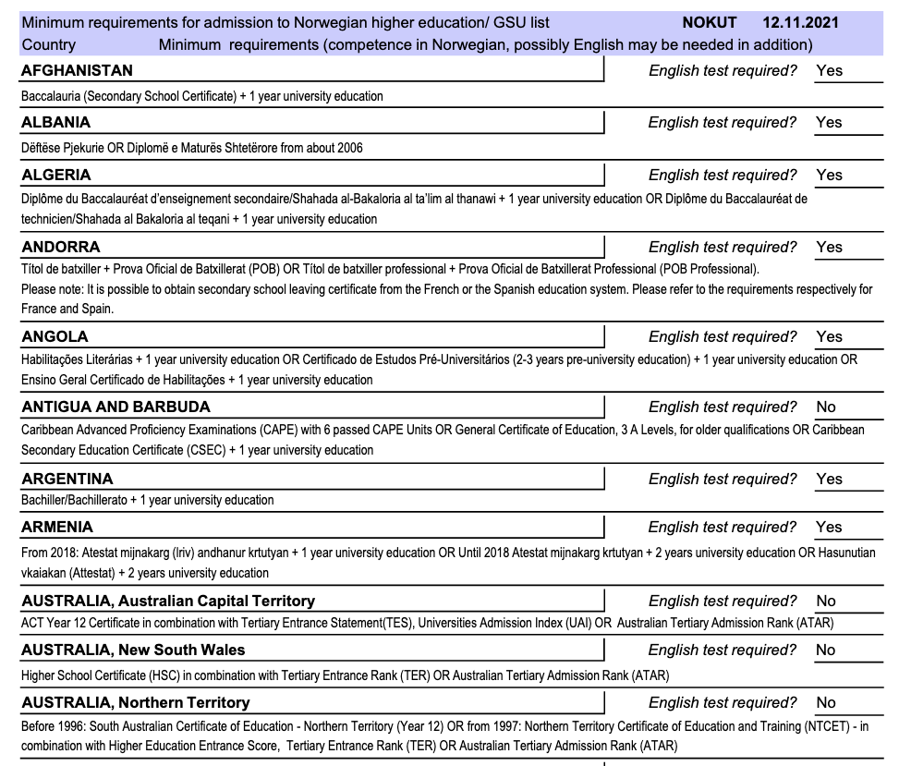
Information sources
GSU-list (Higher Education Entrance Qualification for foreign applicants)
Downloadable in PDF format

Slide 12
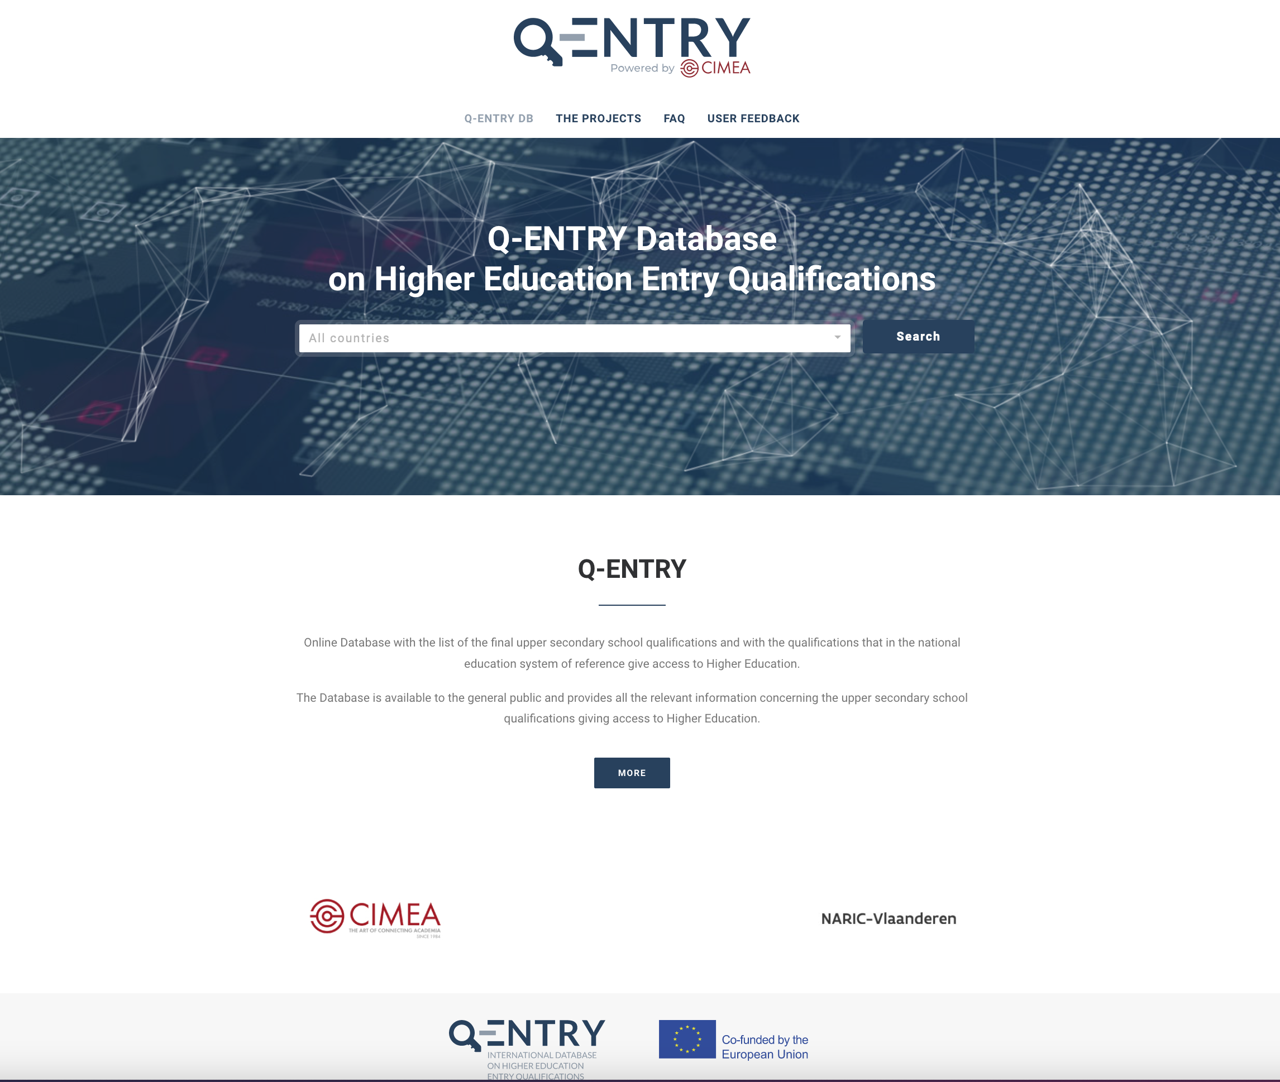
Tools
Q-ENTRY database – www.q-entry.eu
DE FACTO AR
105 qualifications giving access to higher education
55 countries
International Baccalaureate
European Baccalaureate

Slide 13
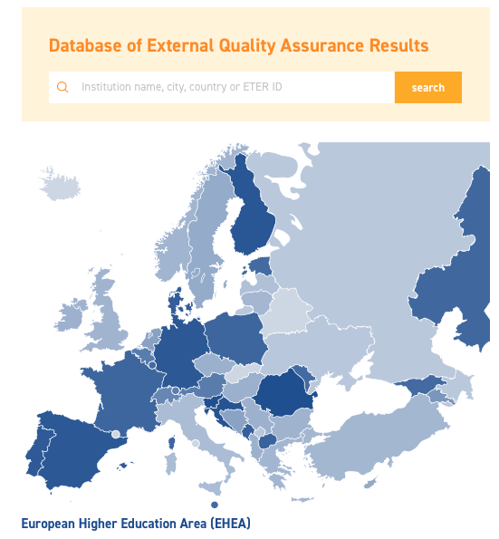
Tools
DEQAR Connect - The Database of External Quality Assurance Reports
AIM
Collect all external quality assurance reports and decisions performed by EQAR-registered agencies in line with the ESG in a European one-stop shop.
OBJECTIVES
Improve access to information on the external QA;
Facilitate the recognition of qualifications;
Facilitate exchange of data and links with other tools
https://www.eqar.eu/deqar-connect/

Slide 14
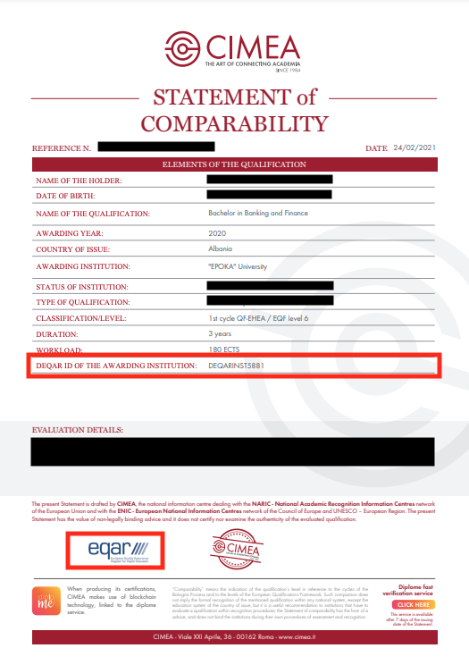


Tools
Integration of the DEQAR database

Slide 15
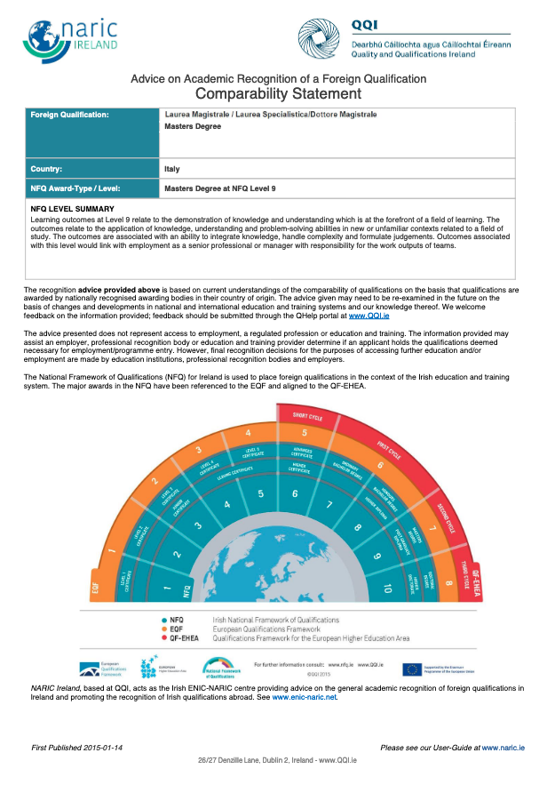
Tools
Standardised statements of comparability
https://qsearch.qqi.ie/WebPart/Search?searchtype=recognitions

Slide 16
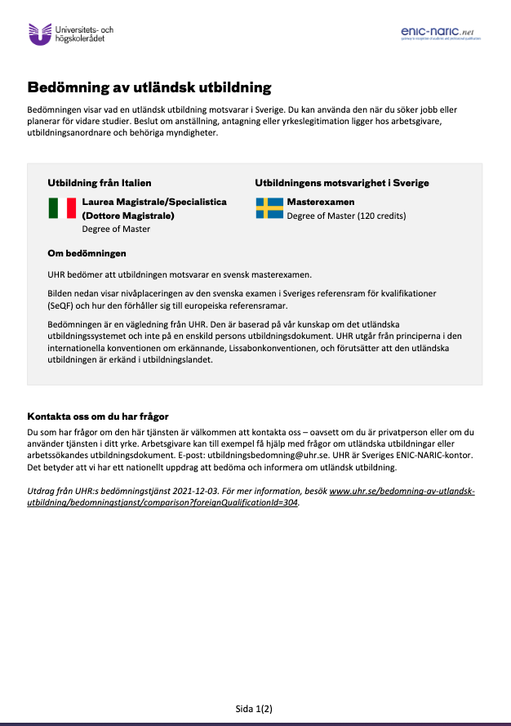
Tools
https://www.uhr.se/bedomning-av-utlandsk-utbildning/bedomningstjanst/

Slide 17
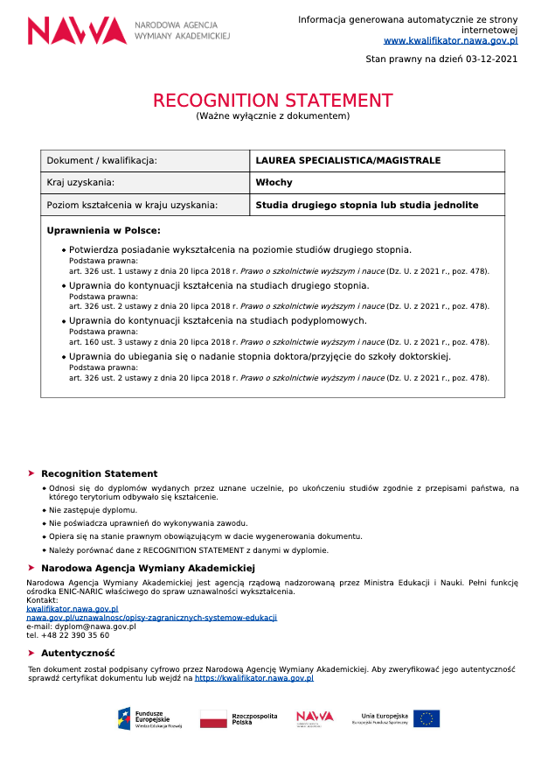
Tools
https://kwalifikator.nawa.gov.pl/

Slide 18
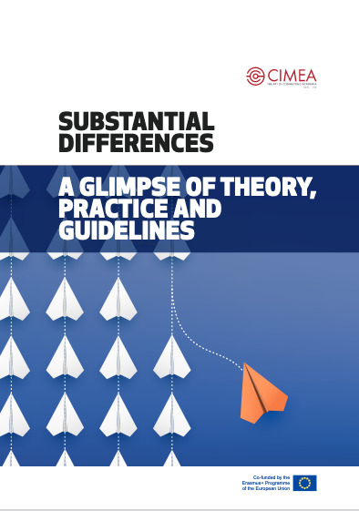
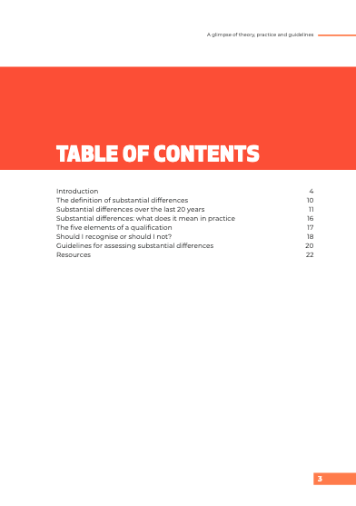
Publications
TPG-LRC project
Substantial differences, A glimps of theory, practice and guidelines

Slide 19

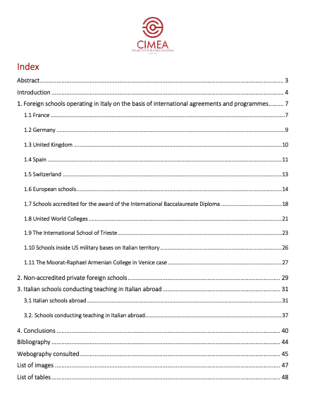
Publications
Foreign Schools in Italy and Italian Schools Abroad. Legislation, Characteristics and Recognition of Qualifications

Slide 20
Thank you!
s.bianco@cimea.it
@CIMEA_Naric
www.cimea.it

